Slide 1
Osher Lifelong Learning Institute, Spring 2022
Contemporary Economic Policy
University of Alabama-Huntsville
April-May, 2022
Host: Jon Haveman, Ph.D.
National Economic Education Delegation

Slide 2
Available NEED Topics Include:
Coronavirus Economics
US Economy
Climate Change
Economic Inequality
Economic Mobility
Trade and Globalization
Minimum Wages
Immigration Economics
Housing Policy
Federal Budgets
Federal Debt
Black-White Wealth Gap
Autonomous Vehicles
US Social Policy

Slide 3
Course Outline
Contemporary Economic Policy
Week 1 (4/11): US Economy & Russia/Ukraine Conflict
Week 2 (4/18): Trade and Globalization (Alan Deardorff, University of Michigan)
Week 3 (4/25): The Black-White Wealth Gap (Stephanie Seguino, Univ. of Vermont)
Week 4 (5/2): Economic Mobility (Kathryn Wilson, Kent State University)
Week 5 (5/9): Cryptocurrencies and the Future of Money (G. Woglom)
Week 6 (5/16): Autonomous Vehicles (Jon Haveman, NEED)

Slide 4
Submitting Questions
Please submit questions in the chat.
I will try to handle them as they come up, but may take them in a bunch as time permits.
We will do a verbal Q&A once the material has been presented.
And the questions in the chat have been addressed.

Slide 5
The Black-White Wealth Gap
Stephanie Seguino, Ph.D.
University of Vermont
April 25, 2022

Slide 6
Outline
Evidence of disparities
Why wealth is important
Sources of disparities
Implications of disparities
Policy solutions

Slide 7
What is Wealth?
Income vs Wealth
Income is the flow of funds into a households each year.
Wealth is a household’s NET asset holdings.
The value of all assets minus the value of all debts.
Assets can be financial and physical.
Assets include:
Owned homes, cars, stocks, businesses, savings and checking accounts, pensions, life insurance…
Debts include:
Home mortgages, car loans, credit cards, and any other significant financial obligations (excl regular bills)…

Slide 8
Evidence

Slide 9
Overall Wealth Distribution
2019 Overall Median: $121,700

Slide 10
Wealth inequality in America

Slide 11
Wealth is More and More Concentrated
99th Percentile
2016 = 7x 1963
Source: Urban Institute

Slide 12
How do we accumulate wealth?
Savings from income.
Earnings from the ownership of financial assets like stocks and bonds (interest).
Appreciation of value of assets such as housing or stocks and bonds.
Inheritance.

Slide 13
Wealth Disparities, 2019
Race/Ethnicity | Mean Wealth | Share of Families | Share of Wealth | Ratio of Shares (Share of Wealth/Share of Families
White, non-Hispanic | $983,400 | 64.9 | 85.3 | 1.3
Black, non-Hispanic | $142,500 | 14.2 | 2.7 | 0.2
Hispanic or Latino | $165,500 | 9.6 | 2.1 | 0.2
Other or Multiple Race | $657,200 | 11.3 | 9.9 | 0.9
Source: Federal Reserve, Survey of Consumer Finances

Slide 14
Evidence of the Gap
Mean is
7x Greater
Median is 8x Greater

Slide 15
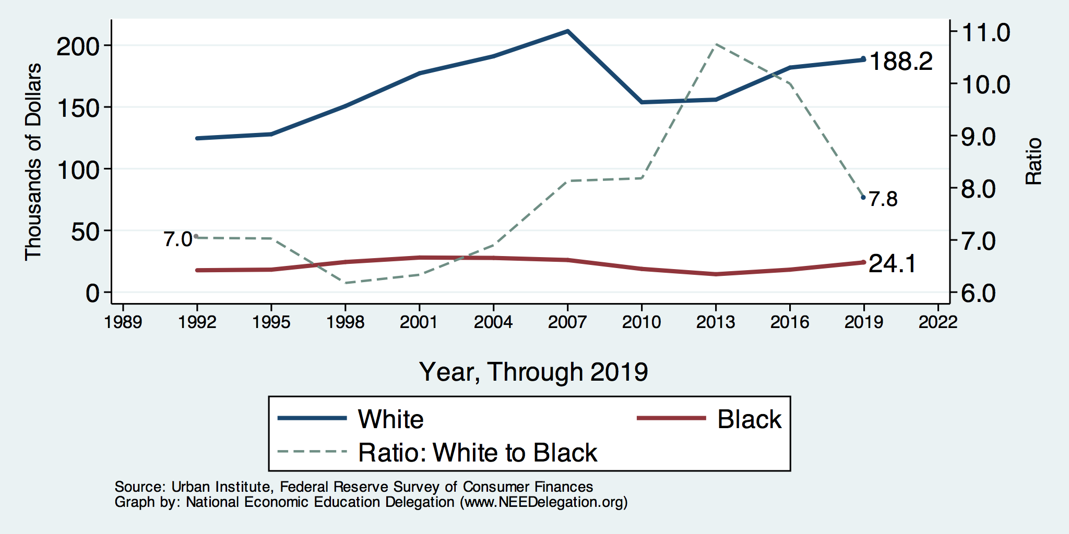
Wealth Gap Over Time: Median

Slide 16
Net Worth by Age and Race
Source: https://www.brookings.edu/blog/up-front/2020/02/27/examining-the-black-white-wealth-gap/

Slide 17
Black Household Incomes Relative to White
Source: pewsocialtrends.org

Slide 18
Black Household Incomes Relative to White
Source: pewsocialtrends.org

Slide 19
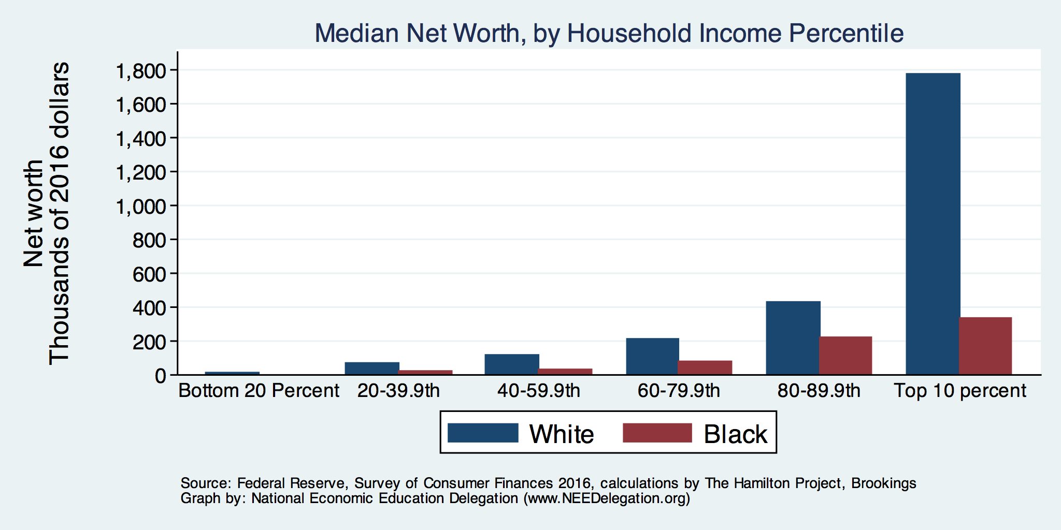
By Household Income

Slide 20
Evidence of Disparities: Zero Wealth

Slide 21
Why Wealth is Important

Slide 22
Widespread Household Wealth Pays Dividends
To individuals in the household
Choices/Agency
Wealth is iterative
And to broader society
Human capital development
Entrepreneurship and innovation

Slide 23
Household Level Benefits
Choices/Life Agency
Finance higher education
Living in good neighborhoods
Saving for retirement
Capital to start a business
w/stand financial hardship
Better legal counsel
Exert political influence
Finance costly medical procedure
Bequests
Wealth is iterative
Wealth begets more wealth.
Access to higher return investments.
Wealth transfers across generations.
Wealth is sticky.

Slide 24
Parental Wealth is Important
Important pre-estate transfer effects on kids:
Influences human capital accumulation.
Influences the returns to education.
Adult incomes of offspring.
There are clearly enormous differences in wealth held by parents of Black and White children.

Slide 25
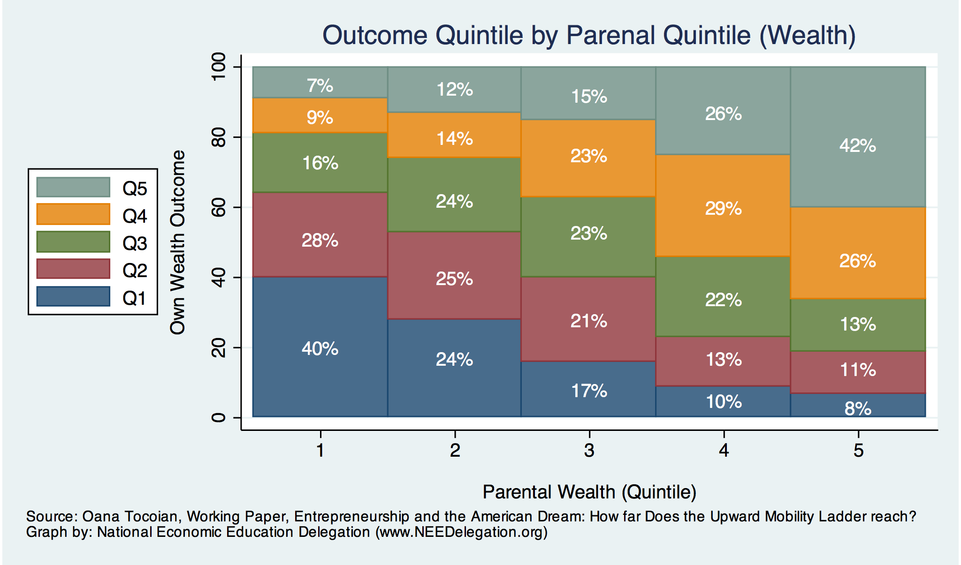
Wealth Mobility

Slide 26
Tangible Benefits for the Broader Economy
More human capital development
Increased entrepreneurship
Greater labor force participation
Healthier labor force
Less social unrest
Less reliance on social programs
Smaller stock of student loans

Slide 27
Sources of Disparities

Slide 28
Events/Policies with Direct Wealth Implications
Slave trade
The first deprivation.
Slavery
40 acres (and a mule)
The second deprivation.
Discriminatory distribution of land.
Freedmen’s Bank
Lax oversite and dissolution.
Jim Crow Laws & Economic Policy
Convict leasing, debt peonage, chain-gang, sharecropping, and lynching.
Homestead Act
Discriminatory distribution of land.
Land theft and destruction
E.g., Black Wall Street – Tulsa, 1921.
GI Bill
Discriminatory access – Levittown
Federal Housing Authority
Redlining
Mortgage interest tax deductions

Slide 29
Results for Black Families
Much lower accumulation of wealth than among White families.
Implications:
Less financial contribution from parents to children.
More difficult access to higher education.
Less access to capital for business formation.
More likely to live in disadvantaged neighborhoods.
Segregation tax
Less access to quality education.
Disparities in availability of resources to build wealth.

Slide 30
Potential Explanations: Differences in…
Educational attainment
Home ownership
Increased savings
Financial literacy
Entrepreneurship
Wages
Family structure
Initial endowment

Slide 31
Wealth by Educational Attainment
Educational Attainment | Net Worth Median | Net Worth Mean
No High School | $22,800 | $157,200
High School | $67,100 | $249,600
Some College | $66,100 | $340,600
College | $292,100 | $1,511,100
71.0%
16.1%
8.6%
4.3%
Source: Federal Reserve Board, Table data are 2016.

Slide 32
Educational Attainment: Policy
How do we increase educational attainment?
Increase universal quality of public schools.
Increased/improved counseling in high schools.
Reduce costs (including living) of attending college.
Increased access to funds for education.
Make publicly available pre-k education.
Mandate kindergarten by age 5.
No one able to drop out before age 18 or at least 11 completed years of education.

Slide 33
Educational Attainment
Median Household Net Worth by Race and Education
Source: Darity, et al., “What We Get Wrong About Closing the Racial Wealth Gap.”

Slide 34
Home Ownership: Households

Slide 35
Home Ownership
Housing Status | Net Worth Median | Net Worth Mean
Renters | $5,200 | $91,100
Owner | $231,400 | $1,034,200

Slide 36
Wealth Equality Through Home Ownership?
Well-documented evidence of historical and ongoing housing and lending discrimination.
Appraisals, buyers, lenders, local laws, covenants…
What about home prices in minority neighborhoods? Even if they buy, they won’t get the appreciation of White neighborhoods.
Home values are 50% lower in majority Black neighborhoods.
23% after adjusting for quality and amenities.
Called the “segregation tax.”
Source: Brookings, Home ownership while black

Slide 37
What Determines Differences in Home Ownership?
Wealth of parents
Ability to borrow – lending discrimination
At all
On equivalent terms to white borrowers
Local ordinances – housing discrimination
Lower appreciation rates of homes in majority Black communities
This makes it a less attractive investment.

Slide 38
Increased Savings
Historical evidence generated by economists ranging from Milton Friedman (1957) to Marjorie Galenson (1972) to Marcus Alexis (1971) to Gittelman and Wolff (2004)…..
All find that after accounting for household income, Blacks have a slightly higher savings rate than Whites.

Slide 39
Financial Literacy
Financial literary helps explain individual wealth differences within racial groups, but none of the wealth differences between racial groups.
The insufficient financial literacy argument is often leveled specifically at Black households.
The argument holds equally with regard to all households of comparable incomes.
Controlling for household income, there is no difference in rates of asset appreciation between Black and White households.

Slide 40
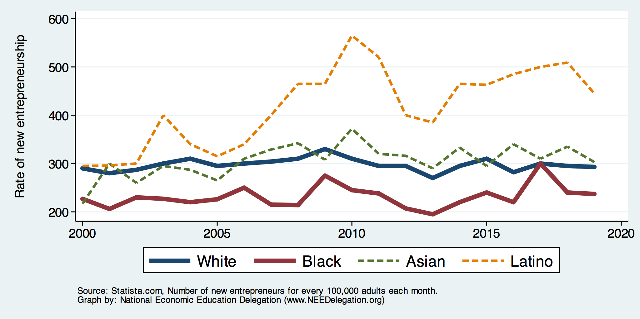
Entrepreneurship: Rate of New Entrepreneurs
Source: Statistica

Slide 41
Explaining Differences in Entrepreneurship
Disparities in access to capital:
Wealth disparities
Specifically, differences in home equity.
Differences in wealth levels of friends and family.
Less likely to rely on banks and more likely to rely on credit cards.
Loans have higher int rates and more likely to be declined.
Less access to venture funds.
Previous business ownership by family.

Slide 42
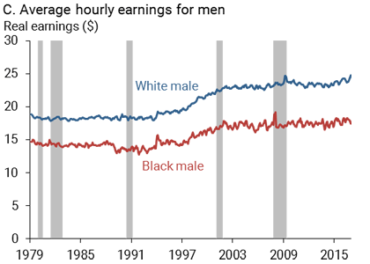
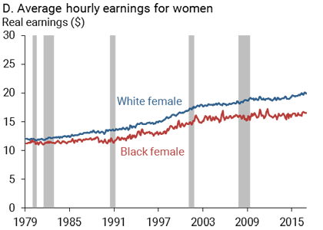
Wage Gap: Controlling for education, age, job type.
Source: https://www.frbsf.org/economic-research/publications/economic-letter/2017/september/disappointing-facts-about-black-white-wage-gap/

Slide 43
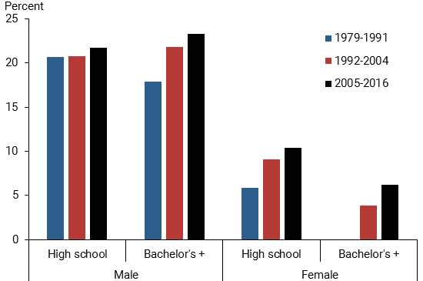
Black-White Earnings Gap by Education
Source: https://www.frbsf.org/economic-research/publications/economic-letter/2017/september/disappointing-facts-about-black-white-wage-gap/

Slide 44
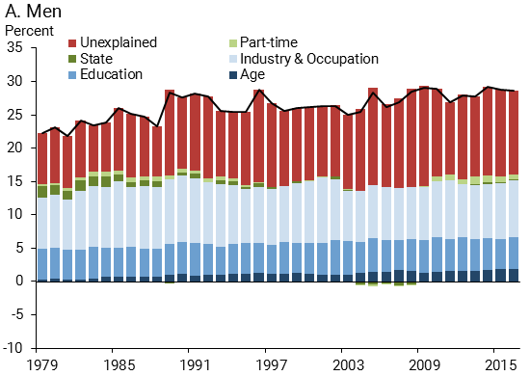
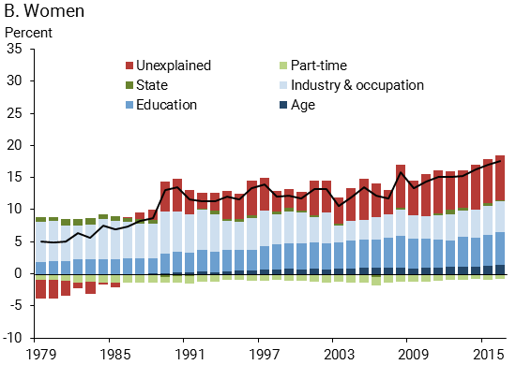
Wage Gap Broken Down
Source: https://www.frbsf.org/economic-research/publications/economic-letter/2017/september/disappointing-facts-about-black-white-wage-gap/

Slide 45
Equality of Income = Equality of Wealth
/
Source: http://hartfordinfo.org/issues/wsd/FamiliesandChildren/Racial-Wealth-Gap-Brief.pdf

Slide 46
Over (under) representation of racial groups in prison
Racial share in prison/Racial share of US population
Notes:
https://www.prisonpolicy.org/graphs/cjrace_life.html with updated demographic and jail data. Other percentages have changed very little.
Racial share of incarceration category/racial share of population

Slide 47
US Drug Arrest Rates per 100,000 by Race

Slide 48
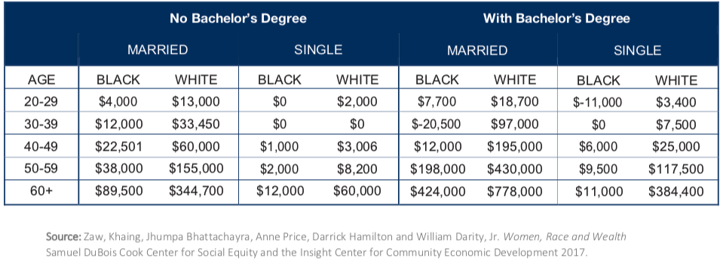
Family Structure

Slide 49
Kids – Household Types

Slide 50
What is Fundamentally Responsible?
Individual behaviors?
Structural characteristics of the economy?
History – policy and otherwise?

Slide 51
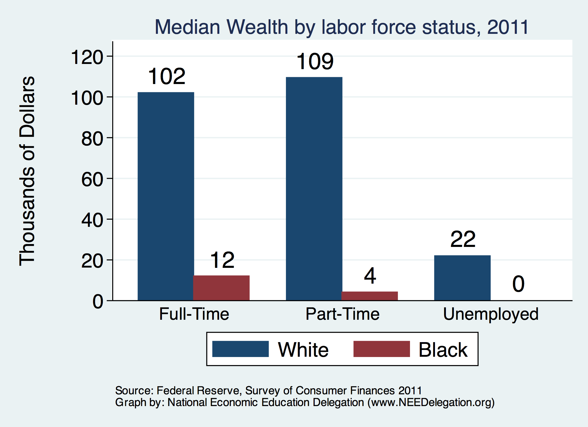
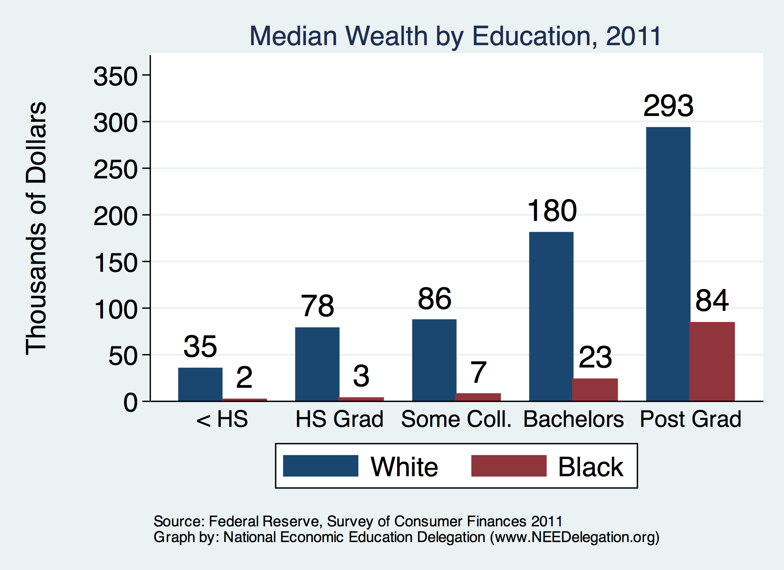
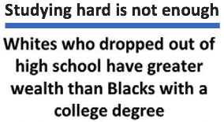
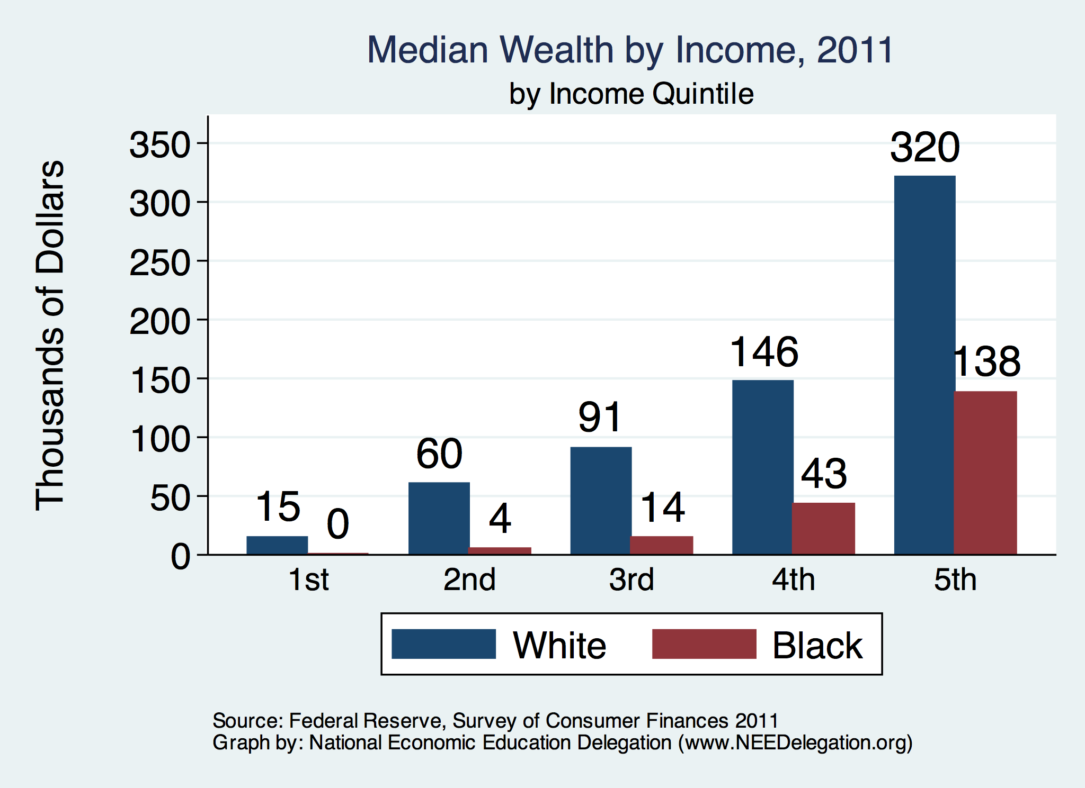

Slide 52
Accounting for the Wealth Gap
30%+ Left
Unaccounted for
Source: https://heller.brandeis.edu/iasp/pdfs/racial-wealth-equity/racial-wealth-gap/roots-widening-racial-wealth-gap.pdf

Slide 53
Policy Options

Slide 54
Categories of Policy Areas
Housing
FHA and redlining
Health Care
Incarceration
Black incarceration rates are very high.
Education
Workforce
Income support and stability
Asset accumulation

Slide 55
Specific Policy Options
Global solutions that affect all source areas
Child Trust Accounts - ”Baby Bonds”
Guaranteed minimum income
Addressing racial disparities directly
Reparations
Aggressive affirmative action.
A new Homestead Act.
Heavily investing in Black communities.
Differential tax treatment.
Labor and other laws that address discrimination
Enforce more aggressively and make adjustments where necessary to increase efficacy.
Fundamental reorientation of asset building agenda.

Slide 56
Reform Criminal Justice System
Legal restrictions on the rights of people who have had contact with the criminal justice system, particularly contact resulting in conviction.
Usually placed in civil and regulatory codes, collateral consequences may limit a person’s:
ability to vote
live in public housing
own a firearm
qualify for an occupational license
serve in the military
receive public benefits (Food Stamps, housing vouchers)
sit on a jury
borrow money for college
Legal restrictions on the rights of people who have had contact with the criminal justice system, particularly contact resulting in conviction.
Usually placed in civil and regulatory codes, collateral consequences may limit a person’s:
ability to vote
live in public housing
own a firearm
qualify for an occupational license
serve in the military
receive public benefits (Food Stamps, housing vouchers)
sit on a jury
borrow money for college

Slide 57
Collateral consequences of contact with criminal justice system
Legal restrictions on the rights of people who have had contact with the criminal justice system, particularly contact resulting in conviction.
Usually placed in civil and regulatory codes, collateral consequences may limit a person’s:
ability to vote
live in public housing
qualify for an occupational license
serve in the military
receive public benefits (Food Stamps, housing vouchers)
sit on a jury
borrow money for college

Slide 58
Gov’t Asset Building Policies

Slide 59
Other Concrete Policy Options
Limit the mortgage interest tax deduction and use the revenues to provide a credit for first-time homebuyers.
Establish automatic savings and retirement plans.
Reduce reliance on student loans while supporting success in postsecondary education.
Offer universal children's savings accounts.
Reform safety net program asset tests, which can act as barriers to saving among low-income families.
Source: Urban Institute

Slide 60
Summary
The Black White wealth gap is enormous (2019)
Mean: White wealth is 6.9x Black wealth.
Median: White wealth is 7.8x Black wealth.
There are many explanations in the common narrative.
Many do not stand up to scrutiny.
Government policies have contributed enormously this gap.
Racial dehumanizing permitted these policies.
Wealth endowments (parental wealth) are enormously important for determining own wealth in adulthood.
Policies that address this relationship are most likely to be effective.
Some form of policy intervention is likely necessary if the gap is to be closed.

Slide 61
Thank you!
Any Questions?
www.NEEDelegation.org
Stephanie Seguino, Ph.D.
Stephanie.Seguino@uvm.edu
Contact NEED: info@NEEDelegation.org
Submit a testimonial: www.NEEDelegation.org/testimonials.php
Become a Friend of NEED: www.NEEDelegation.org/friend.php

